Slide 1
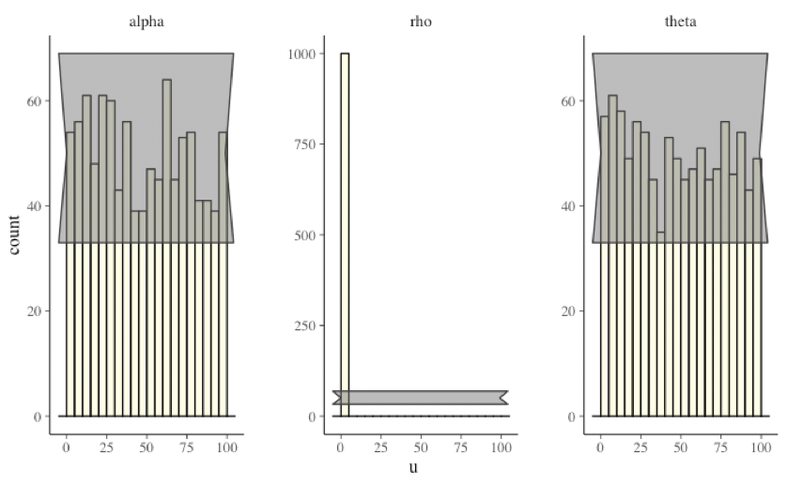

Slide 2
α~N(m, sd) ρ~N(m, sd) | Sd 0.1 | Sd 0.01
mean 0, 0 | .27, .34, .22 | .59, .46, .62
Mean 0.5, 1.4 | .89, .37, .14 | .63, .28, .33

